Slide 1
CSCM10: Presentation
Andrew Gray
445348

Slide 2
Contents
Motivation
Background Information
Aims of the Project
Project Steps
Current Steps
References

Slide 3
Motivation
“It is predicted that by 2025, the global AI market is expected to be almost $60 billion; in 2016, it was just $1.4 billion. Another research says that AI bots will drive up to $33 trillion of annual economic growth and also power 85% of customer service interactions by 2020 [1].”
"Despite popular opinions, games promote learning and discourage negative behaviours. One study illustrates that regular gameplay improved mental health as well as cognitive and social skills [2].”

Slide 4
Motivation
Many people perceive ML to be a black box
A complex technique to master
underlining factors are relatively simple
Creating a teaching and learning tool that incorporates gamification features
Aim to debunk the misconceptions around AI and ML
By educating the concepts of ML
In a fun and engaging way
Fundamentally help change the views of ML

Slide 5
Contents
Motivation
Background Information
Aims of the Project
Project Steps
Current Steps
References

Slide 6
Background Information
Two main areas of Focus:
Gamification
Artificial Intelligence:
Machine Learning.
Picture Source: [3]
Picture Source: [4]

Slide 7
Background Information
Machine Learning
Supervised
Unsupervised Learning
Models:
Linear Regression
Logistic Regression
K-Means
Gaussian Mixture Models
Support Vector Models
PCA and LDA
Picture Source: [5]

Slide 8
Background Information
Gamification
Leader boards
Levels
Challenges
Badges
Points
Check-in
Feedback
Picture Source: [6]

Slide 9
Contents
Motivation
Background Information
Aims of the Project
Project Steps
Current Steps
References

Slide 10

Aims of the Project
Picture Source: [8]
Picture Source: [7]
Picture Source: [9]

Slide 11
Contents
Motivation
Background Information
Aims of the Project
Project Steps
Current Steps
References

Slide 12
Steps for the Project
Gain better fundamentals of Pygame
Start implementing the main game screen
Start implementing the ML model(s)
Start incorporating the ML model(s) into the game
Develop levels (Different Models)
Incorporate Multiplayer
Incorporate Learning Material(s) –
Websites/ Documents
Videos
Develop difficulty settings

Slide 13
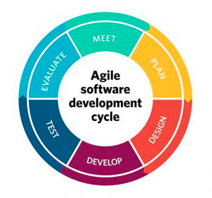
Steps for the Project
Methods:
Agile Approach
Kanban Tools
Tools:
Python
Jupyter Notebook
VS Code
Trello
Picture Source: [7]
Picture Source: [10]
Picture Source: [12]
Picture Source: [12]
Picture Source: [11]

Slide 14
Contents
Motivation
Background Information
Aims of the Project
Project Steps
Current Steps
References

Slide 15
Current First Steps
Picture Source: [14]

Slide 16
Current First Steps
Picture Source: [15]

Slide 17
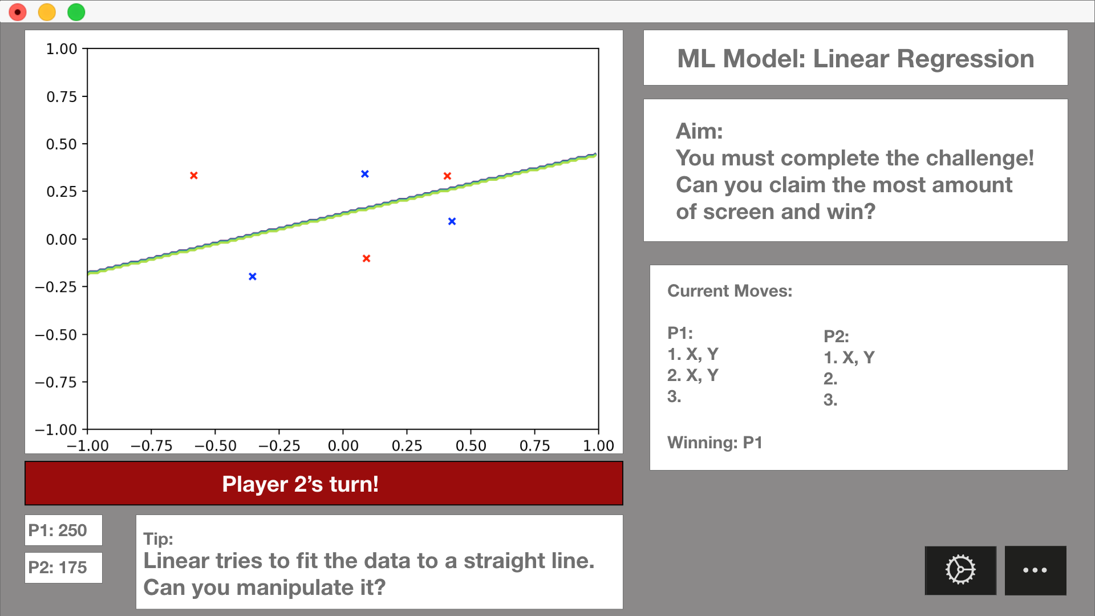
Current First Steps

Slide 18
Contents
Motivation
Background Information
Aims of the Project
Project Steps
Current Steps
References

Slide 19
References
S. Martin. (2019) Top industries getting revolutionised by artificial intelligence. [Online]. Available: https://medium.com/hackernoon/ top-industries-getting-revolutionised-by-artificial-intelligence-686a440857c0
S. Arnold. (2017) 10 important facts about games and learning. [Online]. Available: https://www.classcraft.com/blog/features/10-facts-games-learning/
Super Mario, Retrieved 13th March 2020. Picture, https://www.aliexpress.com/i/32893627970.html
BBC Computer Brain, Retrieved 9th March 2020. Picture, https://www.bbc.co.uk/newsround/49274918
Robot Reading, Retrieved 9th March 2020. Picture, https://github.com/WillCheung2016
Gamification image, Retrieved 8th March 2020. Picture, https://hurix.com/selecting-gamification-services/
Python Logo, Retrieved 9th March 2020. Picture, https://www.pngfind.com/mpng/TJxTJR_python-logo-png-transparent-background-python-logo-png/
Pygame Logo, Retrieved 13th March 2020. Picture, http://www.pygame.org/docs/logos.html
Machine Learning Packages, Retrieved 13th March 2020. Picture, https://www.pyimagesearch.com/2019/01/21/regression-with-keras/
Agile, Retrieved 18th March 2020. Picture, https://project-management.com/10-key-principles-of-agile-software-development
VS Code, Retrieved 18th March 2020. Picture, https://en.wikipedia.org/wiki/Visual_Studio_Code
Jupyter Logo, Retrieved 18th March 2020. Picture, https://towardsdatascience.com/jupyter-lab-evolution-of-the-jupyter-notebook-5297cacde6b
Trello Logo, Retrieved 18th March 2020. Picture, https://trello.com/about/logo
Super Mario Bros. Level, Retrieved 13th March 2020. Picture, https://www.nintendo.co.uk/Games/NES/Super-Mario-Bros--803853.html
Brain Storm, retrieved 13th March 2020. Picture, https://ealdaylight.com/progressive-brainstorm/

